Slide 1
Cisco Certified Network Associate
(CCNA)

Slide 2
Access Control Lists

Slide 3
Part 1: ACL Fundamentals

Slide 4
Overview
Network administrators must figure out how to deny unwanted access to the network while allowing internal users appropriate access to necessary services.
Although security tools, such as passwords, callback equipment, and physical security devices are helpful, they often lack the flexibility of basic traffic filtering and the specific controls most administrators prefer.
For example, a network administrator may want to allow users access to the Internet, but not permit external users telnet access into the LAN.
Routers provide basic traffic filtering capabilities, such as blocking Internet traffic, with access control lists (ACLs).
An ACL is a sequential list of permit or deny statements that apply to addresses or upper-layer protocols.
This module will introduce standard and extended ACLs as a means to control network traffic, and how ACLs are used as part of a security solution.

Slide 5
Overview
In addition, this chapter includes:
  Tips, considerations, recommendations, and general guidelines on how to use ACLs,
  Commands and configurations needed to create ACLs.
  Examples of standard and extended ACLs
  How to apply ACLs to router interfaces.
Access Lists have become powerful tools for controlling the behavior of packets and frames.
Their uses fall into three categories.
  Security Filters protect the integrity of the router and the networks to which it is passing traffic. (CCNA)
  Traffic Filters prevent unnecessary packets from passing onto limited-bandwidth links. (CCNP)
  Other Filters such as dialer lists, route filters, route maps, and queuing lists, must be able to identify certain packets to function properly. (CCNP)

Slide 6
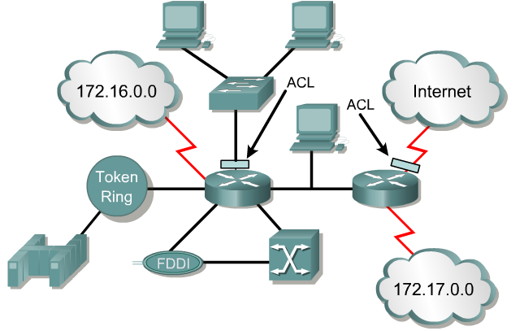
What are ACLs?
Note: Much of the beginning of this module are concepts. These concepts will become much clearer once we begin configuring ACLs.
An access list is a sequential series of commands or filters.
These lists tell the router what types of packets to:
  accept or
  deny
Acceptance and denial can be based on specified conditions.
ACLs applied on the router's interfaces.

Slide 7
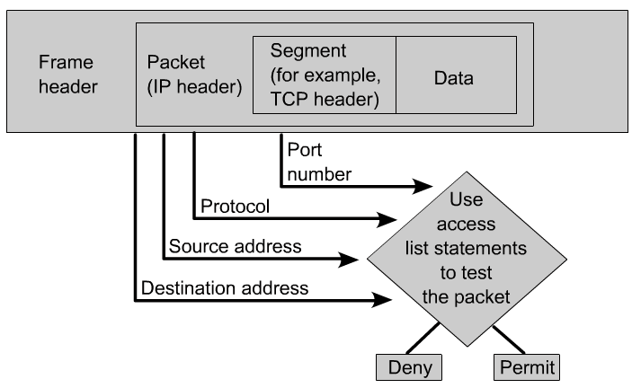
What are ACLs?
The router examines each packet to determine whether to forward or drop it, based on the conditions specified in the ACL.
Some ACL decision points are:
  IP source address
  IP destination addresses
  UDP or TCP protocols
  upper-layer (TCP/UDP) port numbers

Slide 8
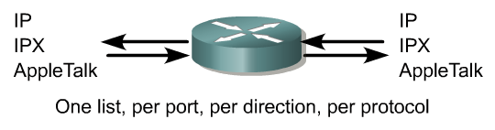

What are ACLs?
ACLs must be defined on a:
  per-protocol (IP, IPX, AppleTalk)
  per direction (in or out)
  per port (interface) basis.
ACLs control traffic in one direction at a time on an interface.
A separate ACL would need to be created for each direction, one for inbound and one for outbound traffic.
Finally every interface can have multiple protocols and directions defined.

Slide 9
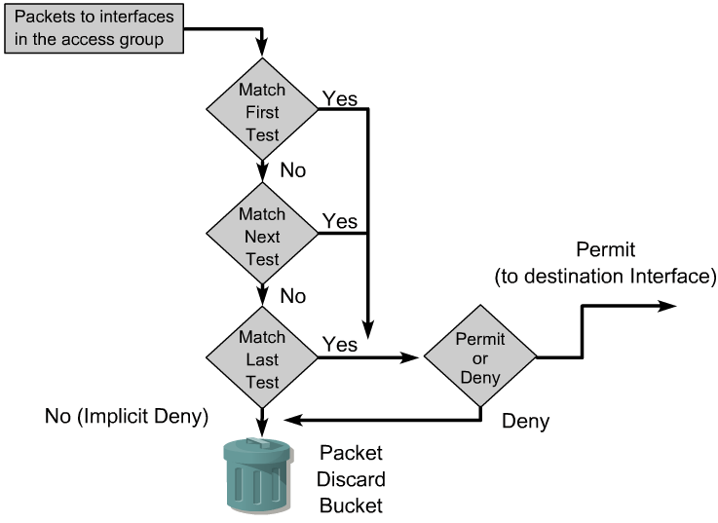
How ACLs work
An ACL is a group of statements that define whether packets are accepted or rejected coming into an interface or leaving an interface.
ACL statements operate in sequential, logical order.
If a condition match is true, the packet is permitted or denied and the rest of the ACL statements are not checked.
If all the ACL statements are unmatched, an implicit "deny any" statement is placed at the end of the list by default. (not visible)
When first learning how to create ACLs, it is a good idea to add the implicit deny at the end of ACLs to reinforce the dynamic presence of the command line..

Slide 10
How ACLs work
Access list statements operate in sequential, logical order.
They evaluate packets from the top down.
Once there is an access list statement match, the packet skips the rest of the statements.
  If a condition match is true, the packet is permitted or denied.
There can be only one access list per protocol per interface.
There is an implicit “deny any” at the end of every access list.
ACLs do not block packets that originate within the router. (ie. pings, telnets, etc.)

Slide 11
Two types of ACLs
Standard IP ACLs
  Can only filter on source IP addresses
Extended IP ACLs
  Can filter on:
    Source IP address
    Destination IP address
    Protocol (TCP, UDP)
    Port Numbers (Telnet – 23, http – 80, etc.)
    and other parameters

Slide 12
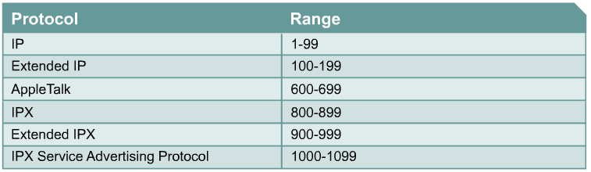
Creating ACLs
(Standard IP)

Slide 13
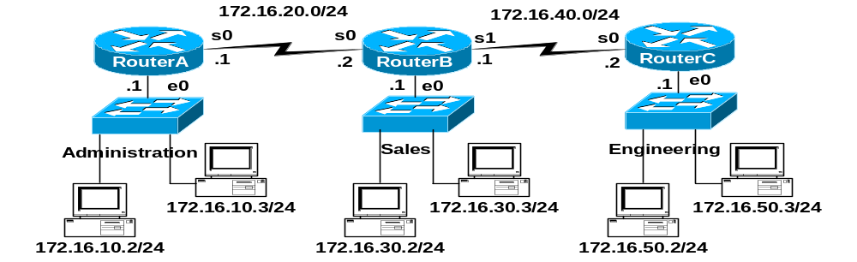
Learn by example!
Preferred, this access list will work to all existing and new interfaces on RouterB.
RouterB(config)#access-list 10 permit 172.16.30.2
Implicit “deny any” -do not need to add this, discussed later
RouterB(config)#access-list 10 deny 0.0.0.0 255.255.255.255
RouterB(config)# interface e 0
RouterB(config-if)# ip access-group 10 in

Slide 14
Note on inbound access lists
When an access lists applied to an inbound interface, the packets are checked against the access list before any routing table lookup process occurs.
We will see how outbound access list work in a moment, but they are applied after the forwarding decision is made, after the routing table lookup process takes place and an exit interface is determined.
Once a packet is denied by an ACL, the router sends an ICMP “Destination Unreachable” message, with the code value set to “Administratively Prohibited” to the source of the packet.
RouterB(config)#access-list 10 deny 172.16.30.2
RouterB(config)#access-list 10 permit any
Implicit “deny any” (do not need to add this, discussed later):
RouterB(config)#access-list 10 deny 0.0.0.0 255.255.255.255
RouterB(config)# interface e 0
RouterB(config-if)# ip access-group 10 in

Slide 15
Notes from www.cisco.com
Traffic coming into the router is compared to ACL entries based on the order that the entries occur in the router.
New statements are added to the end of the list.
The router keeps looking until it has a match.
If no matches are found when the router reaches the end of the list, the traffic is denied.
For this reason, you should have the frequently hit entries at the top of the list.
There is an "implied deny" for traffic that is not permitted.
A single-entry ACL with only one "deny" entry has the effect of denying all traffic.
You must have at least one "permit" statement in an ACL or all traffic will be blocked.
access-list 10 permit 10.1.1.1 0.0.0.255
access-list 10 deny ip any (implicit)

Slide 16

Time for Wildcard Masks!
A wildcard mask address:
Tells how much of the packet’s source IP address (or destination IP address) needs to match for this condition to be true.

Slide 17
Time for Wildcard Masks!
A wildcard mask is a 32-bit quantity that is divided into four octets.
A wildcard mask is paired with an IP address.
The numbers one and zero in the mask are used to identify how to treat the corresponding IP address bits.
The term wildcard masking is a nickname for the ACL mask-bit matching process and comes from of an analogy of a wildcard that matches any other card in the game of poker.
Wildcard masks have no functional relationship with subnet masks.
  They are used for different purposes and follow different rules.
Subnet masks start from the left side of an IP address and work towards the right to extend the network field by borrowing bits from the host field.
Wildcard masks are designed to filter individual or groups of IP addresses permitting or denying access to resources based on the address.

Slide 18
Wildcard Masks!
“Trying to figure out how wildcard masks work by relating them to subnet masking will only confuse the entire matter. The only similarity between a wildcard mask and a subnet mask is that they are both thirty-two bits long and use ones and zeros for the mask.”
This is not entirely true.
Although it is very important that you understand how a wildcard mask works, it can also be thought as an inverse subnet mask.
We will see examples in a moment…

Slide 19

Test Condition
Test Conditon
10101100.00010000.00000000.00000000
00000000.00000000.11111111.11111111
------------------------------------
10101100.00010000.any value.any value
A Match…
Matching packets will look like this…
The packet
Wildcard masking used to identify how to treat the corresponding IP address bits.
  0 - “check the corresponding bit value.”
  1 - “do not check (ignore) that corresponding bit value.”
A zero in a bit position of the access list mask indicates that the corresponding bit in the address must be checked and must match for condition to be true.
A one in a bit position of the access list mask indicates the corresponding bit in the address is not “interesting”, does not need to match, and can be ignored.

Slide 20
Wildcard Masks!
Test Condition
Test Conditon
10101100.00010000.00000000.00000000
00000000.00000000.11111111.11111111
------------------------------------
10101100.00010000.any value.any value
Must Match
No Match Necessary
A Match…
The packet
Resulting in the bits that must match or doesn’t matter.
Matching packets will look like this.
  0 - “check the corresponding bit value.”
  1 - “do not check (ignore) that corresponding bit value.”

Slide 21
Example – Using Wildcard Masks
Task:
  Want RouterA to permit entire sales network and just the 172.16.50.2 station.
  Deny all other traffic from entering Administrative network.

Slide 22
“any” keyword
RouterA(config)#access-list 11 deny 0.0.0.0 255.255.255.255
Or
RouterA(config)#access-list 11 deny any
any = 0.0.0.0 255.255.255.255
Simply put, the any option substitutes 0.0.0.0 for the IP address and 255.255.255.255 for the wildcard mask.
This option will match any address that it is compared against.

Slide 23
A note about outbound access lists
But can reach this interface
Denied
Denied
RouterA(config)#access-list 11 permit 172.16.30.0 0.0.0.255
RouterA(config)#access-list 11 permit 172.16.50.2 0.0.0.0
RouterA(config)#access-list 11 deny 0.0.0.0 255.255.255.255
RouterA(config)# interface e 0
RouterA(config-if)#ip access-group 11 out
This will deny packets from 172.16.30.0/24 from reaching all devices in the 172.16.10.0/24 Administration LAN, except RouterA’s Ethernet 0 interface, of 172.16.10.1. The access list will need to be applied on Router A’s Serial 0 interface for it to be denied on RouterA’s Ethernet 0 interface. A better soluton is to use an Extended Access list. (coming)

Slide 24
“host” option
RouterB(config)#access-list 10 permit 192.168.1.100 0.0.0.0
RouterB(config)#access-list 10 permit host 192.168.1.100
The host option substitutes for the 0.0.0.0 mask.
This mask requires that all bits of the ACL address and the packet address match.
The host keyword precedes the IP address.
This option will match just one address.

Slide 25
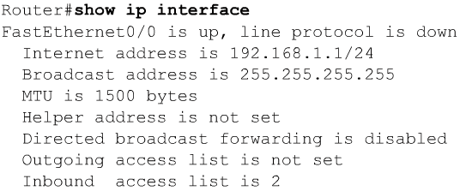
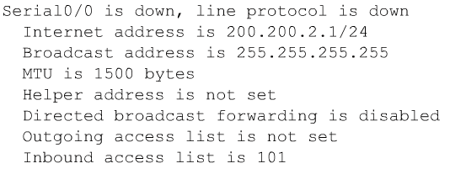
Verifying Access Lists

Slide 26
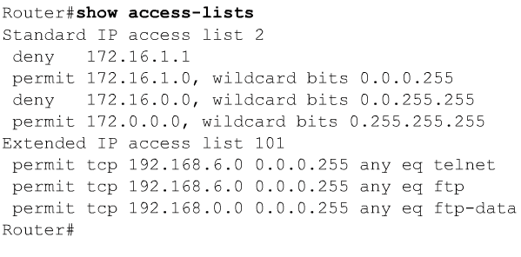
Verifying Access Lists

Slide 27

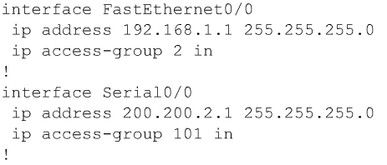
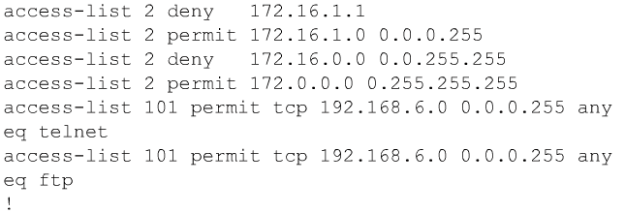
Verifying Access Lists
Note: More than one interface can use the same access-list.

Slide 28
ACL Operations

Slide 29
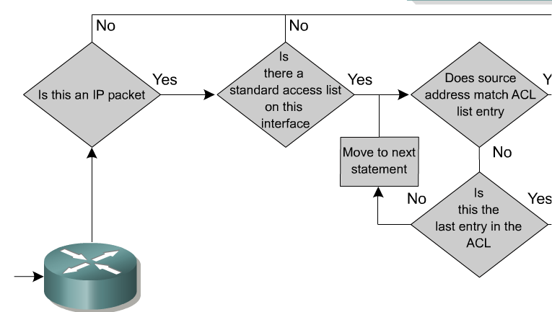
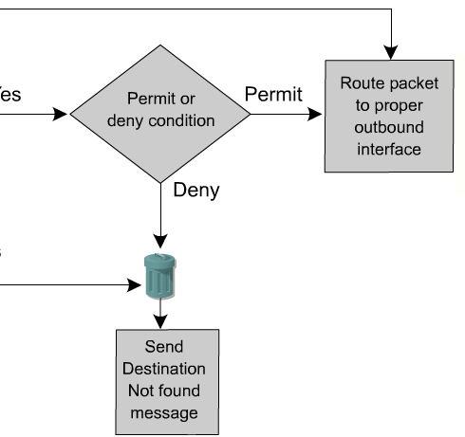
Inbound Standard Access Lists
Inbound Access Lists
RouterA(config)# interface e 0
RouterA(config-if)#ip access-group 11 in
With inbound Access Lists the IOS checks the packets before it is sent to the Routing Table Process.
With outbound Access Lists, the IOS checks the packets after it is sent to the Routing Table Process, except destined for the router’s own interface.
  This is because the output interface is not known until the forwarding decision is made.

Slide 30
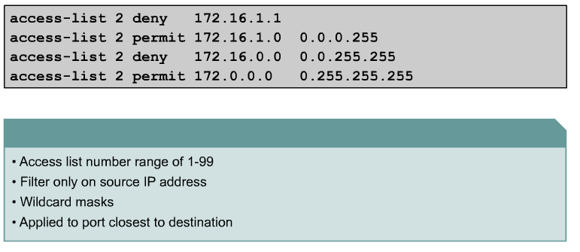
Standard ACL
We will see why in a moment.
The full syntax of the standard ACL command is:
Router(config)#access-list access-list-number {deny | permit} source [source-wildcard ] [log]
The no form of this command is used to remove a standard ACL. This is the syntax: (Deletes entire ACL!)
Router(config)#no access-list access-list-number

Slide 31
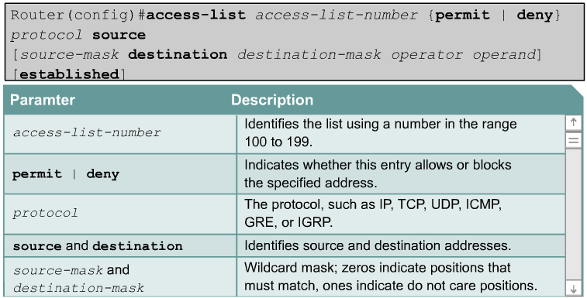
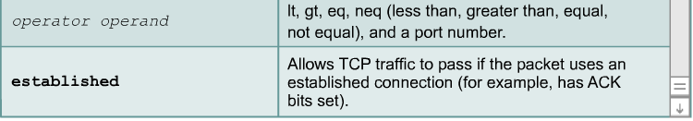
Extended Access Lists

Slide 32
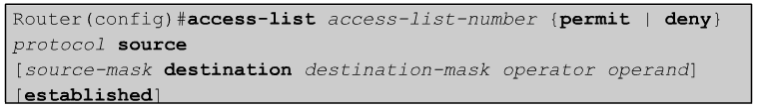
Extended Access Lists
Extended ACLs are used more often than standard ACLs because they provide a greater range of control.
Extended ACLs check the source and destination packet addresses as well as being able to check for protocols and port numbers.
This gives greater flexibility to describe what the ACL will check.
Packets can be permitted or denied access based on where the packet originated and its destination as well as protocol type and port addresses.

Slide 33
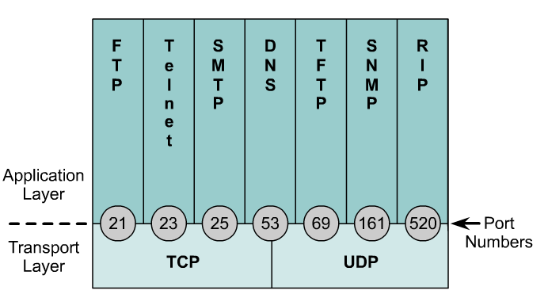
Extended Access Lists
Operator and operand can also refer to ICMP Types and Codes or whatever the protocol is being checked.
If the operator and operand follow the source address it refers to the source port
If the operator and operand follow the destination address it refers to the destination port.

Slide 34
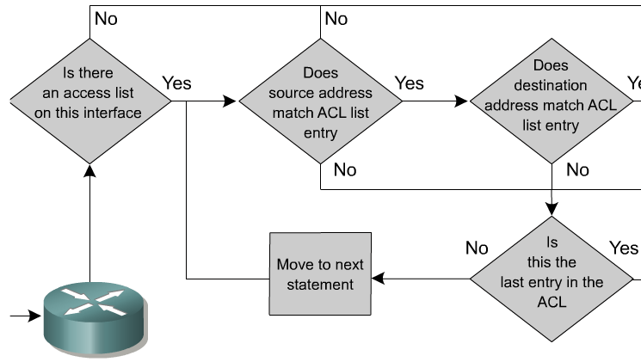
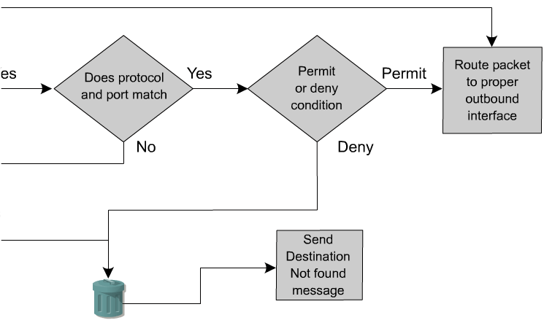
Inbound Extended Access Lists
Inbound Access Lists
RouterA(config)# interface e 0
RouterA(config-if)#ip access-group 11 in
With inbound Access Lists the IOS checks the packets before it is sent to the Routing Table Process.
With outbound Access Lists, the IOS checks the packets after it is sent to the Routing Table Process.
  This is because the output interface is not known until the forwarding decision is made.

Slide 35
Notes from www.cisco.com
In the following example, the last entry is sufficient.
You do not need the first three entries because TCP includes Telnet, and IP includes TCP, User Datagram Protocol (UDP), and Internet Control Message Protocol (ICMP).
access-list 101 permit tcp host 10.1.1.2 host 172.16.1.1 eq telnet
access-list 101 permit tcp host 10.1.1.2 host 172.16.1.1
access-list 101 permit udp host 10.1.1.2 host 172.16.1.1
access-list 101 permit ip 10.1.1.0 0.0.0.255 172.16.1.0 0.0.0.255

Slide 36
Named ACLs
IP named ACLs were introduced in Cisco IOS Software Release 11.2.
Allows standard and extended ACLs to be given names instead of numbers.
The advantages that a named access list provides are:
  Intuitively identify an ACL using an alphanumeric name.
  Eliminate the limit of 798 simple and 799 extended ACLs
  Named ACLs provide the ability to modify ACLs without deleting and then reconfiguring them.
  It is important to note that a named access list will allow the deletion of statements but will only allow for statements to be inserted at the end of a list.
  Even with named ACLs it is a good idea to use a text editor to create them.

Slide 37
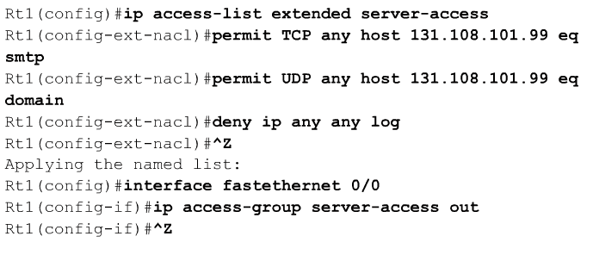
Named ACLs
A named ACL is created with the ip access-list command.
This places the user in the ACL configuration mode.

Slide 38
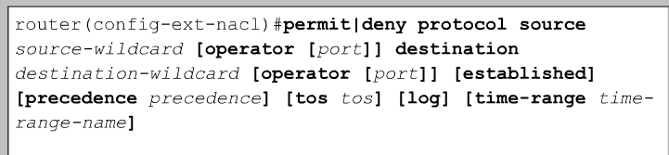
Named ACLs
In ACL configuration mode, specify one or more conditions to be permitted or denied.
This determines whether the packet is passed or dropped when the ACL statement matches.

Slide 39
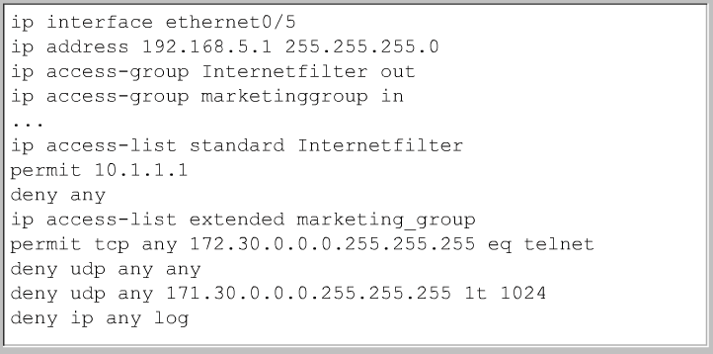

Named ACLs

Slide 40
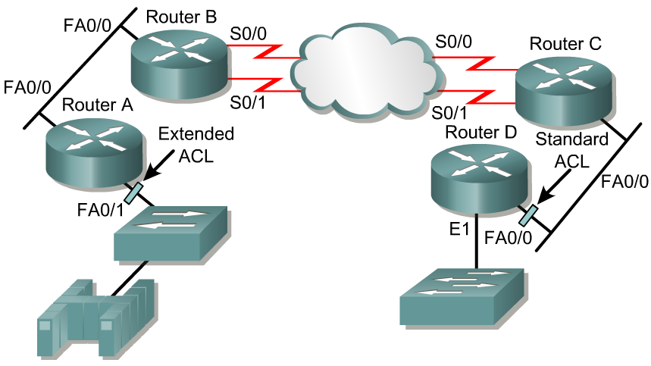
Placing ACLs
Source 10.0.0.0/8
Destination 172.16.0.0/16
The general rule:
Standard ACLs do not specify destination addresses, so they should be placed as close to the destination as possible.
Put the extended ACLs as close as possible to the source of the traffic denied.

Slide 41
Placing ACLs
Source 10.0.0.0/8
Destination 172.16.0.0/16
If the ACLs are placed in the proper location, not only can traffic be filtered, but it can make the whole network more efficient.
If traffic is going to be filtered, the ACL should be placed where it has the greatest impact on increasing efficiency.

Slide 42
Placing ACLs – Extended Example
deny telnet deny ftp permit any
Source 10.0.0.0/8
Destination 172.16.0.0/16
Policy is to deny telnet or FTP Router A LAN to Router D LAN.
All other traffic must be permitted.
Several approaches can accomplish this policy.
The recommended approach uses an extended ACL specifying both source and destination addresses.

Slide 43
Placing ACLs – Extended Example
deny telnet deny ftp permit any
Source 10.0.0.0/8
RouterA
Destination 172.16.0.0/16
interface fastethernet 0/1
access-group 101 in
access-list 101 deny tcp any 172.16.0.0 0.0.255.255 eq telnet
access-list 101 deny tcp any 172.16.0.0 0.0.255.255 eq ftp
access-list 101 permit ip any any
Place this extended ACL in Router A.
Then, packets do not cross Router A's Ethernet, do not cross the serial interfaces of Routers B and C, and do not enter Router D.
Traffic with different source and destination addresses will still be permitted.

Slide 44
Placing ACLs – Extended Example
deny telnet deny ftp permit any
Source 10.0.0.0/8
RouterA
Destination 172.16.0.0/16
interface fastethernet 0/1
access-group 101 in
access-list 101 deny tcp any 172.16.0.0 0.0.255.255 eq telnet
access-list 101 deny tcp any 172.16.0.0 0.0.255.255 eq ftp
access-list 101 permit ip any any
If the permit ip any any is not used, then no traffic is permitted.
Be sure to permit ip and not just tcp or all udp traffic will be denied.

Slide 45
Placing ACLs – Standard Example
deny 10.0.0.0 permit any
Source 10.0.0.0/8
Destination 172.16.0.0/16
interface fastethernet 0/0
access-group 10 in
access-list 10 deny 10.0.0.0 0.255.255.255
access-list 10 permit any
RouterD
Standard ACLs do not specify destination addresses, so they should be placed as close to the destination as possible.
If a standard ACL is put too close to the source, it will not only deny the intended traffic, but all other traffic to all other networks.

Slide 46
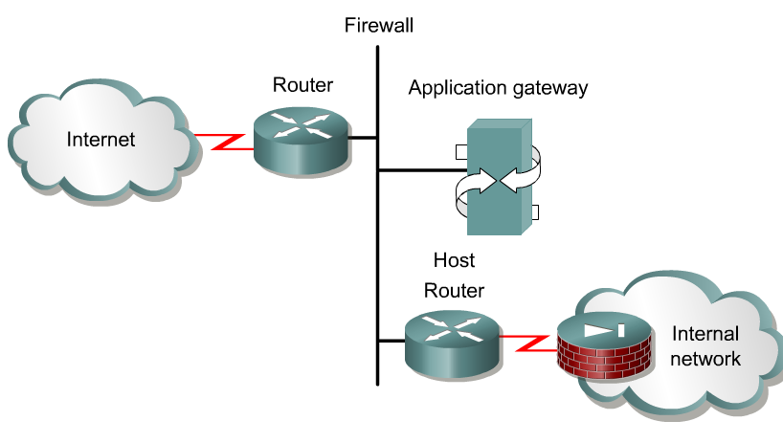
Firewalls
A firewall is an architectural structure that exists between the user and the outside world to protect the internal network from intruders.
In most circumstances, intruders come from the global Internet and the thousands of remote networks that it interconnects.
Typically, a network firewall consists of several different machines that work together to prevent unwanted and illegal access.
ACLs should be used in firewall routers, which are often positioned between the internal network and an external network, such as the Internet.
The firewall router provides a point of isolation so that the rest of the internal network structure is not affected.
ACLs can be used on a router positioned between the two parts of the network to control traffic entering or exiting a specific part of the internal network.

Slide 47
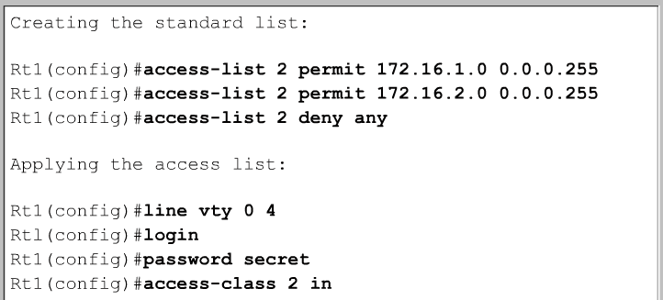
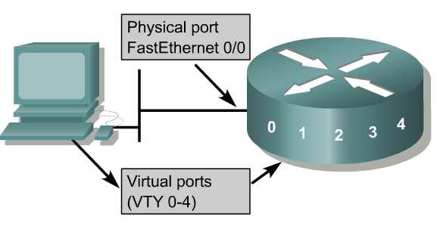
Restricting Virtual Terminal Access to a Router
Rt1(config-line)#
The purpose of restricted vty access is increased network security.
Access to vty is also accomplished using the Telnet protocol to make a nonphysical connection to the router.
As a result, there is only one type of vty access list. Identical restrictions should be placed on all vty lines as it is not possible to control which line a user will connect on.

Slide 48
Restricting Virtual Terminal Access to a Router
Rt1(config-line)#
Standard and extended access lists apply to packets traveling through a router.
ACLs do not block packets that originate within the router.
An outbound Telnet extended access list does not prevent router initiated Telnet sessions, by default.

Slide 49
Lab Session

